Slide 1
Laplace Transform Problems

Slide 2
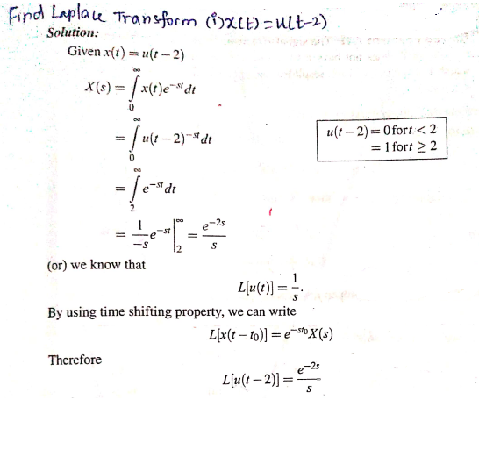

Slide 3


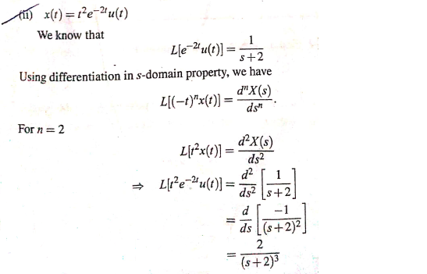

Slide 4

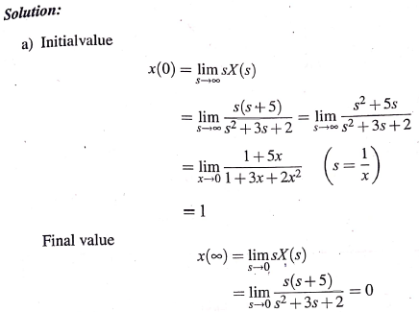
Find the Initial and Final values for following transform

Slide 5
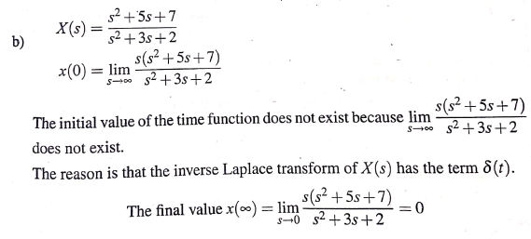
Find the Initial and Final values for following transform

Slide 6
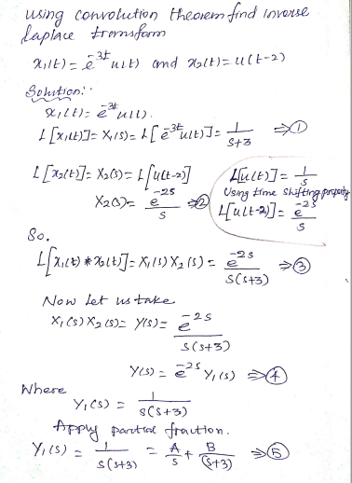

Slide 7
